Slide 1
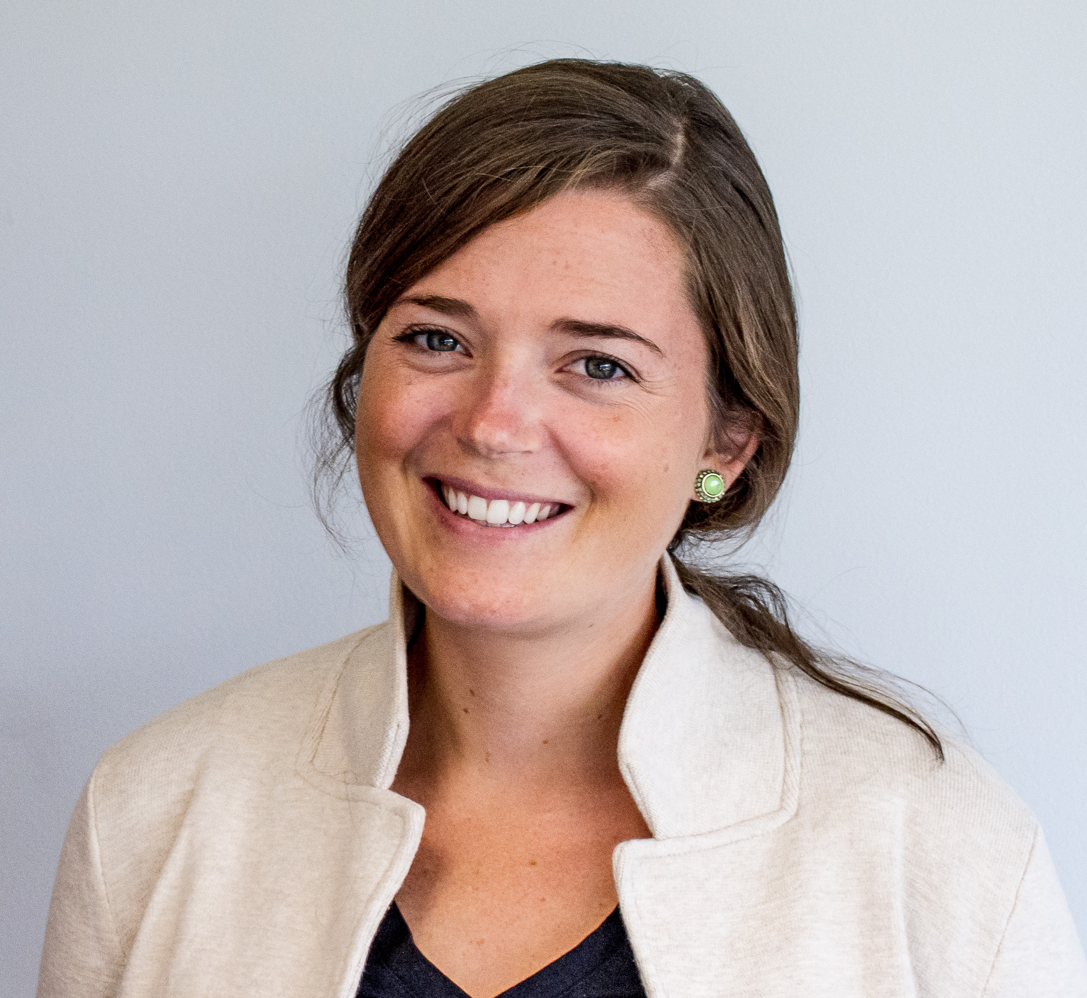
Instructions: Complete the text box below so that it does not extend beyond the boundaries of the blue box. Do not change the font from Calibri 18 point.
Bio: Annie Murphy is a marine scientist with expertise in benthic biogeochemistry, microbial ecology, aquaculture research, and marine environmental change. Her expertise lies at the interface between benthic community ecology and biogeochemistry with interest in the response of aquatic ecosystems to anthropogenic disturbances. She leads projects assessing the benthic habitats associated with offshore wind areas and develops hypothesis-driven benthic monitoring plans to investigate effects of construction and operation of offshore wind on benthic functions. Dr. Murphy participates in several working groups aimed at advancing the science in the offshore wind space including the Regional Synthesis Group within NY E-TWG, the habitat subcommittee of the Regional Wildlife Science Collaborative (RWSC), ICES Working Group on Marine Benthal and Renewable Energy Developments (WGMBRED), and UN Global Compact Working Group on Net Biodiversity Positive Offshore Renewables.
Why MOCEAN: To collaborate with other researchers in exploring the role of renewables infrastructure on ecosystem ecology.
Broad Question: How does the introduction of novel substrate (like turbine foundations) change the flow of energy through the ecosystem?
Focused Question: To what extent do offshore wind structures facilitate carbon sequestration through biological activity that draws carbon to the seafloor?
Annie Murphy,
INSPIRE Environmental
Ecosystem Ecology, Benthic Function, Carbon and Nutrient Cycling

Slide 2
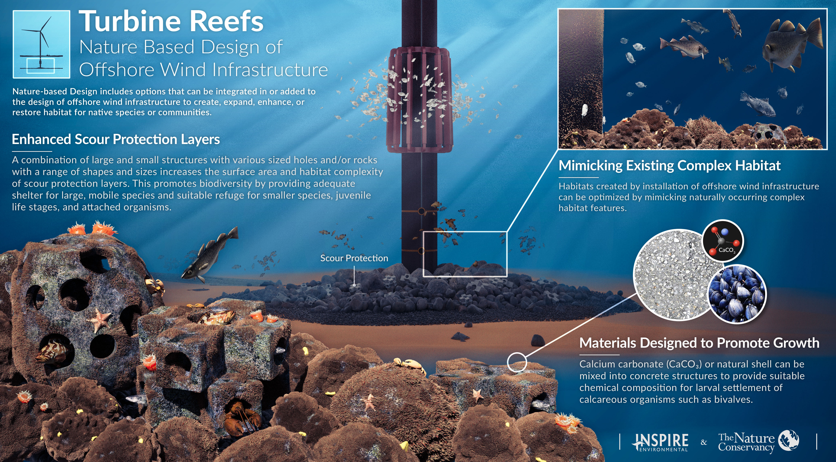

Slide 3
Instructions: Add your suggested Videos in the “New Videos” Tabs
https://docs.google.com/spreadsheets/d/1KkMGkxsSaFtcIgnDu2EvVG_xEdgA-SN4cwIARXCjSqQ/edit?usp=sharing
 |  | Length | Direct Video Link or
Catagory | Topic | (min:sec) | Page with Video Link
General
G1 | How to build offshore wind farms | 6:46 | https://www.youtube.com/watch?v=hQwgXrb3XPs
G2 | Building of a Wind Farm | 22:31 | https://www.youtube.com/watch?v=FiMC58I5ve8
G3 | Transportion of Components | 4:44 | https://www.youtube.com/watch?app=desktop&v=oHXN9qq-S6Y
G4 | Grand Challenges Wind Energy | 88:35 | https://www.youtube.com/watch?app=desktop&v=PdKvmwsFGPE
G5 | Testing of GE 12 MW Drive Train | 1:00 | https://ore.catapult.org.uk/press-releases/haliade-x-arrival-uk/
G6 (DK) | Making of a Wind Turbine | 49:42 | https://www.youtube.com/watch?v=8NXLKRW1IEU&t=2516s
G7 (DK) | How Big Can They Get Real Eng. | 13:49 | https://www.youtube.com/watch?v=wr7QZ364jPY&feature=youtu.be
G8 | Onshore Wind Farm | 49:28 | https://www.youtube.com/watch?app=desktop&v=a5ENMhjcoxQ
G9 | How Wind Farms Work | 5:28 | https://www.youtube.com/watch?v=qSWm_nprfqE
G10 | What's Inside of a Wind Turbine | 9:53 | https://www.youtube.com/watch?v=LNXTm7aHvWc
G11 | Heroes of Burbo Bank Extension | 14:19 | https://www.youtube.com/watch?v=6qIGfth8zgU
G12 | Small Size Wind Turbines | 59:24 | https://www.youtube.com/watch?v=fx4pUFkyhdc
G13 | Broad & Complete Introduction | 105:00 | https://www.youtube.com/watch?v=qQHYs8xQO5A
G14 | Global Offshore Wind Atlas | 91:02 | https://www.irena.org/renewables/Knowledge-Gateway/webinars/2015/Jan/Launch-of-the-Global-Wind-Atlas-presented-by-IRENA-and-DTU
G15 | Offshore Wind Market Report | 56:52 | https://www.youtube.com/watch?v=6w7a4IK1d_8
Fixed Base Foundations
F1 (DK) | Monopile Fabrication | 3:55 | https://www.youtube.com/watch?v=3ILFaNSOZGQ
Click on the link below for an example

